Slide 1
basic tutorial

Slide 2
uses
Complete lab inventory
Use the SDS database to verify whether a chemical is located in the lab or not
Where the chemical is located
Hazards associated with the chemical
Notes:
In general, the workflow will be as outlined above.
Upon receiving a new chemical, assuming it has an SDS provided, write or attach somewhere: date received, location which it will be stored, & supplier; and then drop off into the future folder/box/device/etc which will be placed in or around Sara’s office.
If the SDS is not included, look up the proper one on the manufacturers website and complete the above steps.
If an SDS cannot be found, include as much information about the chemical as possible (CAS number is most helpful) and drop off with the above information.

Slide 3
workflow
Received a new chemical? Place SDS into “SDS Drop-off” in S.Hecht’s office
date received
location(s) of storage
e.g. “Lab 107” or “Lab 107, under sink”
Supplier
Include Technical Data Sheet if available
If SDS not included…
lookup chemical on manufacturer website
print SDS and proceed as above
Full name of chemical + CAS number, synonyms, etc
include above information & drop off
Still can’t find it?
Use Chemwatch or ask S.Hecht to use it
Notes:
In general, the workflow will be as outlined above.
Upon receiving a new chemical, assuming it has an SDS provided, write or attach somewhere: date received, location which it will be stored, & supplier; and then drop off into the future folder/box/device/etc which will be placed in or around Sara’s office.
If the SDS is not included, look up the proper one on the manufacturers website and complete the above steps.
If an SDS cannot be found, include as much information about the chemical as possible (CAS number is most helpful) and drop off with the above information.

Slide 4
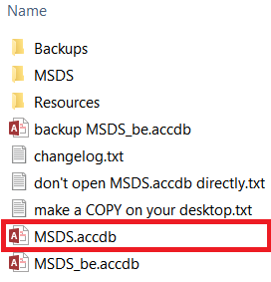
tutorial
Access the MSDS database directory
X:\ASUS\Dublin\cas-j\0 - Yu\MSDS Access
Make a copy of the file on your desktop
MSDS.accdb
Notes:
Copy the file “MSDS.accdb” to your desktop (or wherever you want it) from the directory: X:\ASUS\Dublin\cas-j\0 - Yu\MSDS Access
This is your own personal copy of the front end.
You’ll be launching this frontend to gain access to the database.
Customize it or ruin it all you want, if you mess it up simply delete it and re-copy the front end from the above location.
Launch the file and to the left you should see some “forms” called:
1-Search Chemical
2-Add/Edit Chemical
Number 1 is basically a “read-only” copy of number 2.
Launch number 1 if you are simply trying to search for an MSDS or find where a chemical is located
Number 2 is used only if you are adding a new chemical or , e.g., need to edit a chemicals location, remove a chemical, etc.

Slide 5
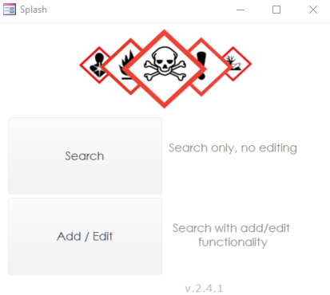
tutorial
Initial startup may prompt something
Accept the prompt, allow the database access to the computer or whatever it asks for
Select search or add/edit from the splash screen
Search: for searching only
Add / Edit: to edit or add SDS entries
Notes:
Copy the file “MSDS.accdb” to your desktop (or wherever you want it) from the directory: X:\ASUS\Dublin\cas-j\0 - Yu\MSDS Access
This is your own personal copy of the front end.
You’ll be launching this frontend to gain access to the database.
Customize it or ruin it all you want, if you mess it up simply delete it and re-copy the front end from the above location.
Launch the file and to the left you should see some “forms” called:
1-Search Chemical
2-Add/Edit Chemical
Number 1 is basically a “read-only” copy of number 2.
Launch number 1 if you are simply trying to search for an MSDS or find where a chemical is located
Number 2 is used only if you are adding a new chemical or , e.g., need to edit a chemicals location, remove a chemical, etc.

Slide 6
search
Let’s start with SEARCH
Click the Search button
Notes:
Copy the file “MSDS.accdb” to your desktop (or wherever you want it) from the directory: X:\ASUS\Dublin\cas-j\0 - Yu\MSDS Access
This is your own personal copy of the front end.
You’ll be launching this frontend to gain access to the database.
Customize it or ruin it all you want, if you mess it up simply delete it and re-copy the front end from the above location.
Launch the file and to the left you should see some “forms” called:
1-Search Chemical
2-Add/Edit Chemical
Number 1 is basically a “read-only” copy of number 2.
Launch number 1 if you are simply trying to search for an MSDS or find where a chemical is located
Number 2 is used only if you are adding a new chemical or , e.g., need to edit a chemicals location, remove a chemical, etc.

Slide 7
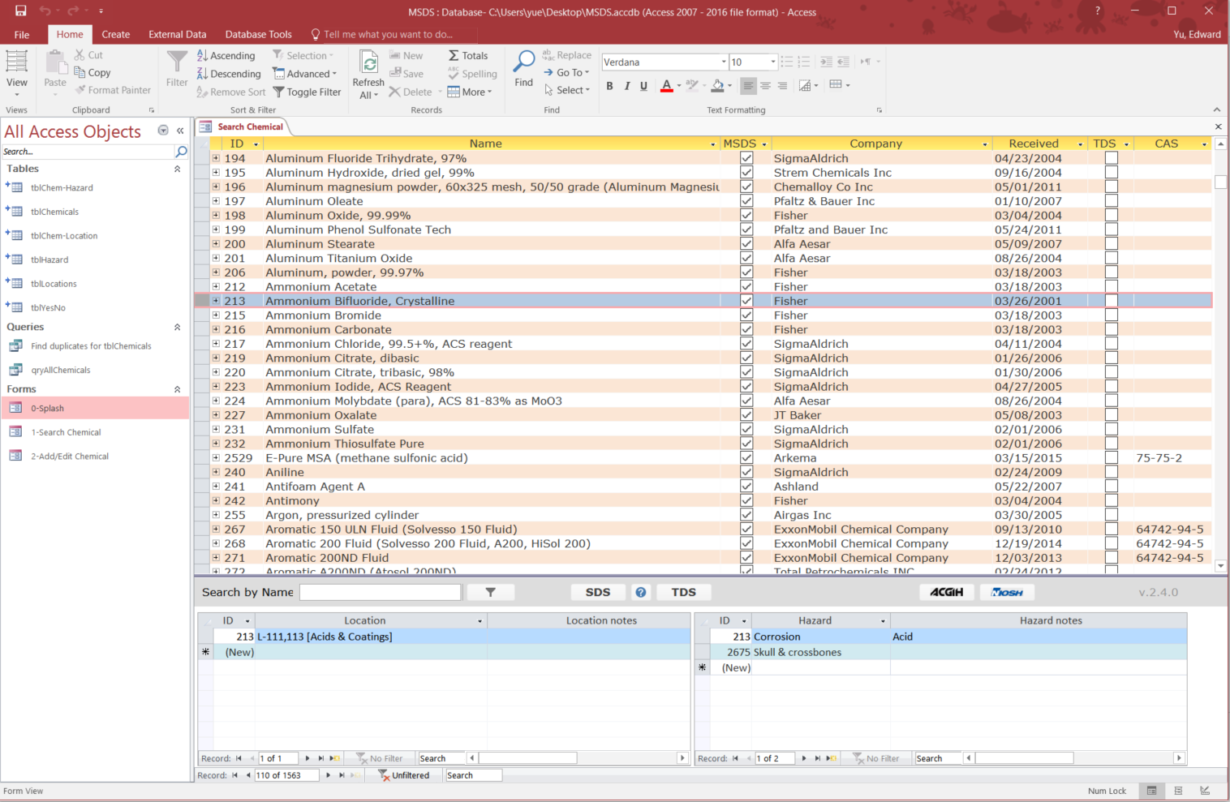
search
Let’s start with SEARCH
Click the Search button
Notes:
Copy the file “MSDS.accdb” to your desktop (or wherever you want it) from the directory: X:\ASUS\Dublin\cas-j\0 - Yu\MSDS Access
This is your own personal copy of the front end.
You’ll be launching this frontend to gain access to the database.
Customize it or ruin it all you want, if you mess it up simply delete it and re-copy the front end from the above location.
Launch the file and to the left you should see some “forms” called:
1-Search Chemical
2-Add/Edit Chemical
Number 1 is basically a “read-only” copy of number 2.
Launch number 1 if you are simply trying to search for an MSDS or find where a chemical is located
Number 2 is used only if you are adding a new chemical or , e.g., need to edit a chemicals location, remove a chemical, etc.

Slide 8
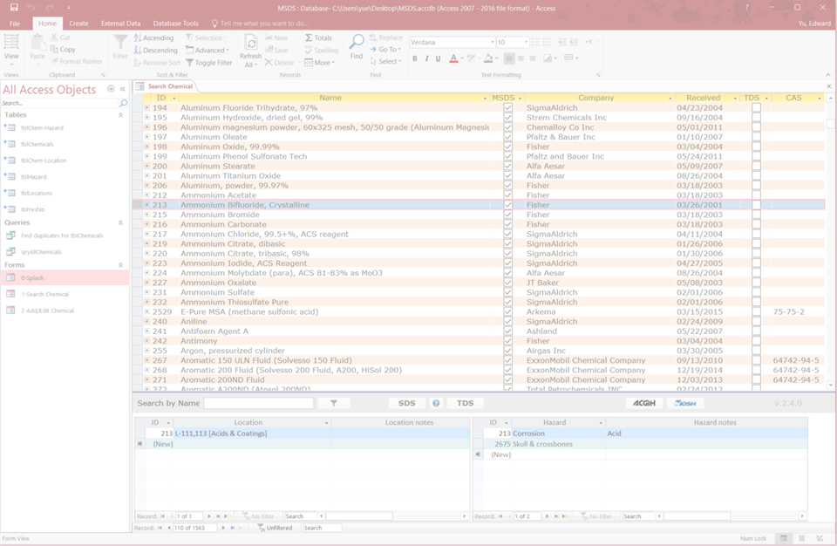
search
Open SDS, if available
OSHA quick card
Open TDS, if available
Open ACGIH or NIOSH
documents
Search bar
Notes:
Copy the file “MSDS.accdb” to your desktop (or wherever you want it) from the directory: X:\ASUS\Dublin\cas-j\0 - Yu\MSDS Access
This is your own personal copy of the front end.
You’ll be launching this frontend to gain access to the database.
Customize it or ruin it all you want, if you mess it up simply delete it and re-copy the front end from the above location.
Launch the file and to the left you should see some “forms” called:
1-Search Chemical
2-Add/Edit Chemical
Number 1 is basically a “read-only” copy of number 2.
Launch number 1 if you are simply trying to search for an MSDS or find where a chemical is located
Number 2 is used only if you are adding a new chemical or , e.g., need to edit a chemicals location, remove a chemical, etc.

Slide 9
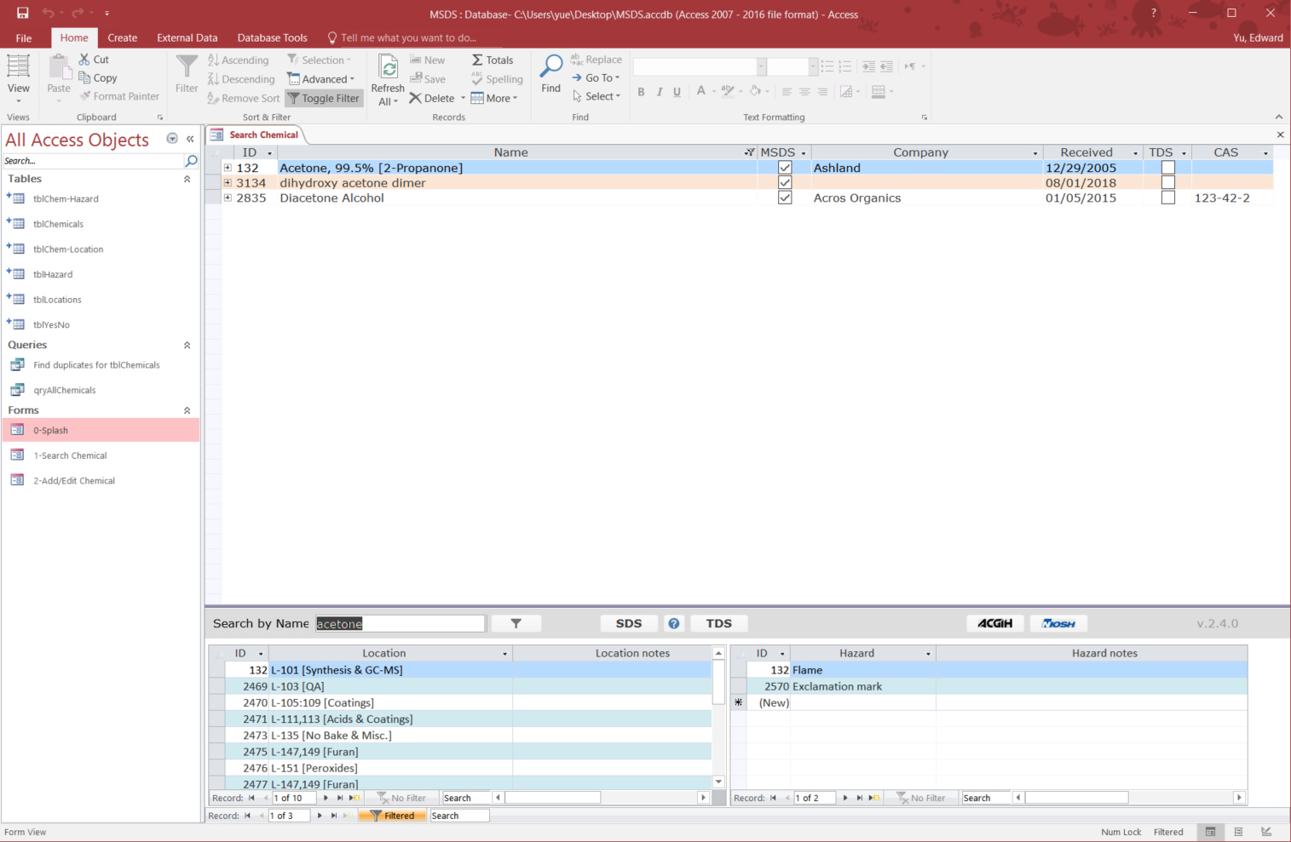
search
Notes:
Copy the file “MSDS.accdb” to your desktop (or wherever you want it) from the directory: X:\ASUS\Dublin\cas-j\0 - Yu\MSDS Access
This is your own personal copy of the front end.
You’ll be launching this frontend to gain access to the database.
Customize it or ruin it all you want, if you mess it up simply delete it and re-copy the front end from the above location.
Launch the file and to the left you should see some “forms” called:
1-Search Chemical
2-Add/Edit Chemical
Number 1 is basically a “read-only” copy of number 2.
Launch number 1 if you are simply trying to search for an MSDS or find where a chemical is located
Number 2 is used only if you are adding a new chemical or , e.g., need to edit a chemicals location, remove a chemical, etc.

Slide 10
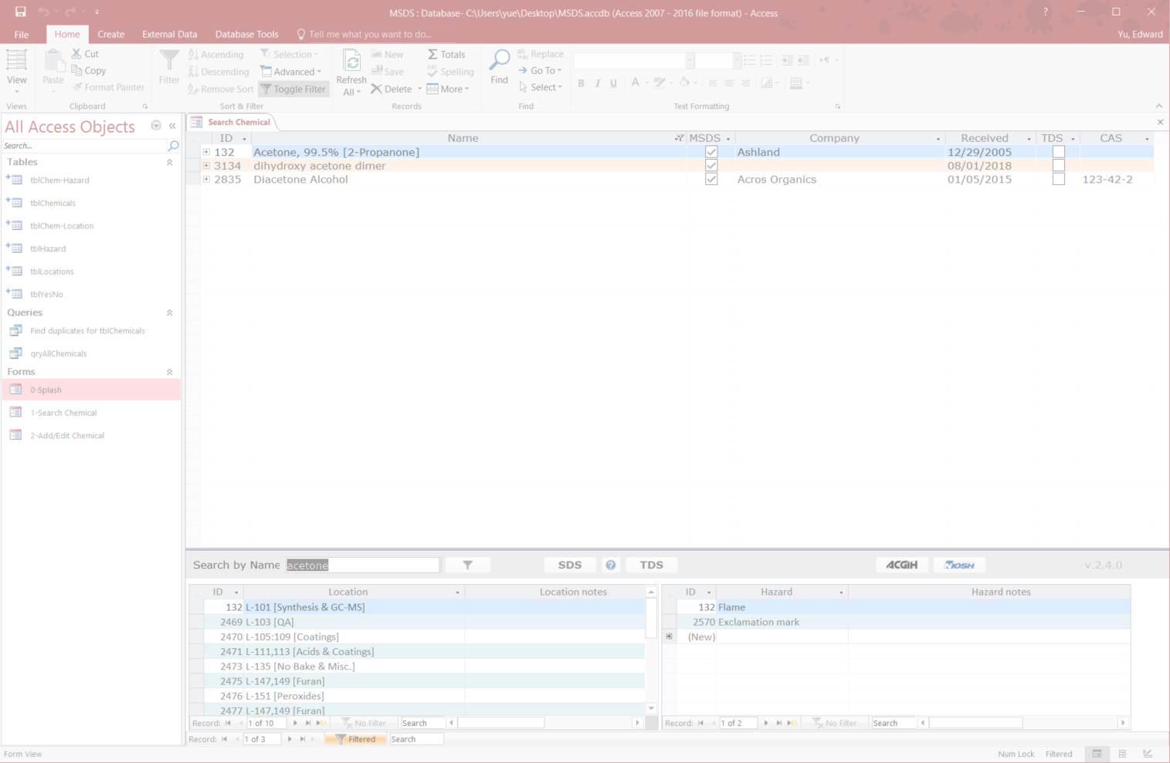
search
1. Search for chemical name (relies on network connection, potentially slow)
2. Select correct chemical from list
Locations of chemical, listed
Hazards of chemical, listed
Notes:
Copy the file “MSDS.accdb” to your desktop (or wherever you want it) from the directory: X:\ASUS\Dublin\cas-j\0 - Yu\MSDS Access
This is your own personal copy of the front end.
You’ll be launching this frontend to gain access to the database.
Customize it or ruin it all you want, if you mess it up simply delete it and re-copy the front end from the above location.
Launch the file and to the left you should see some “forms” called:
1-Search Chemical
2-Add/Edit Chemical
Number 1 is basically a “read-only” copy of number 2.
Launch number 1 if you are simply trying to search for an MSDS or find where a chemical is located
Number 2 is used only if you are adding a new chemical or , e.g., need to edit a chemicals location, remove a chemical, etc.

Slide 11
ADD / EDIT
New chemical? Need to edit an old chemical?
Click the Add / Edit button
Notes:
Copy the file “MSDS.accdb” to your desktop (or wherever you want it) from the directory: X:\ASUS\Dublin\cas-j\0 - Yu\MSDS Access
This is your own personal copy of the front end.
You’ll be launching this frontend to gain access to the database.
Customize it or ruin it all you want, if you mess it up simply delete it and re-copy the front end from the above location.
Launch the file and to the left you should see some “forms” called:
1-Search Chemical
2-Add/Edit Chemical
Number 1 is basically a “read-only” copy of number 2.
Launch number 1 if you are simply trying to search for an MSDS or find where a chemical is located
Number 2 is used only if you are adding a new chemical or , e.g., need to edit a chemicals location, remove a chemical, etc.

Slide 12
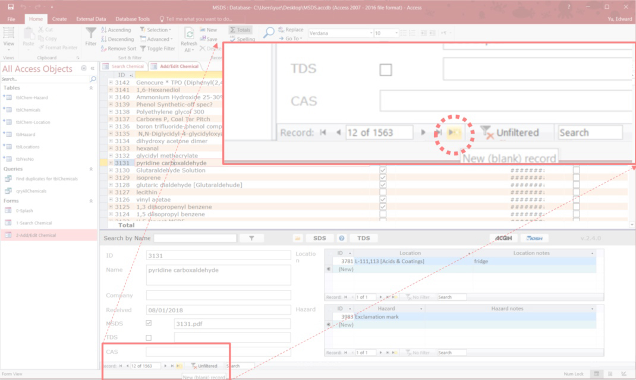
tutorial – add/edit
If you need to add a new chemical,
Click the “New (blank) record” button
Notes:
Before adding a new chemical, you’ll of course want to make sure it isn’t in the system already.
After you’ve searched for the chemical in question and ensured it isn’t in the database, click the “New (blank) record” button, circled in red above (right arrow with a yellow asterisk next to it)

Slide 13
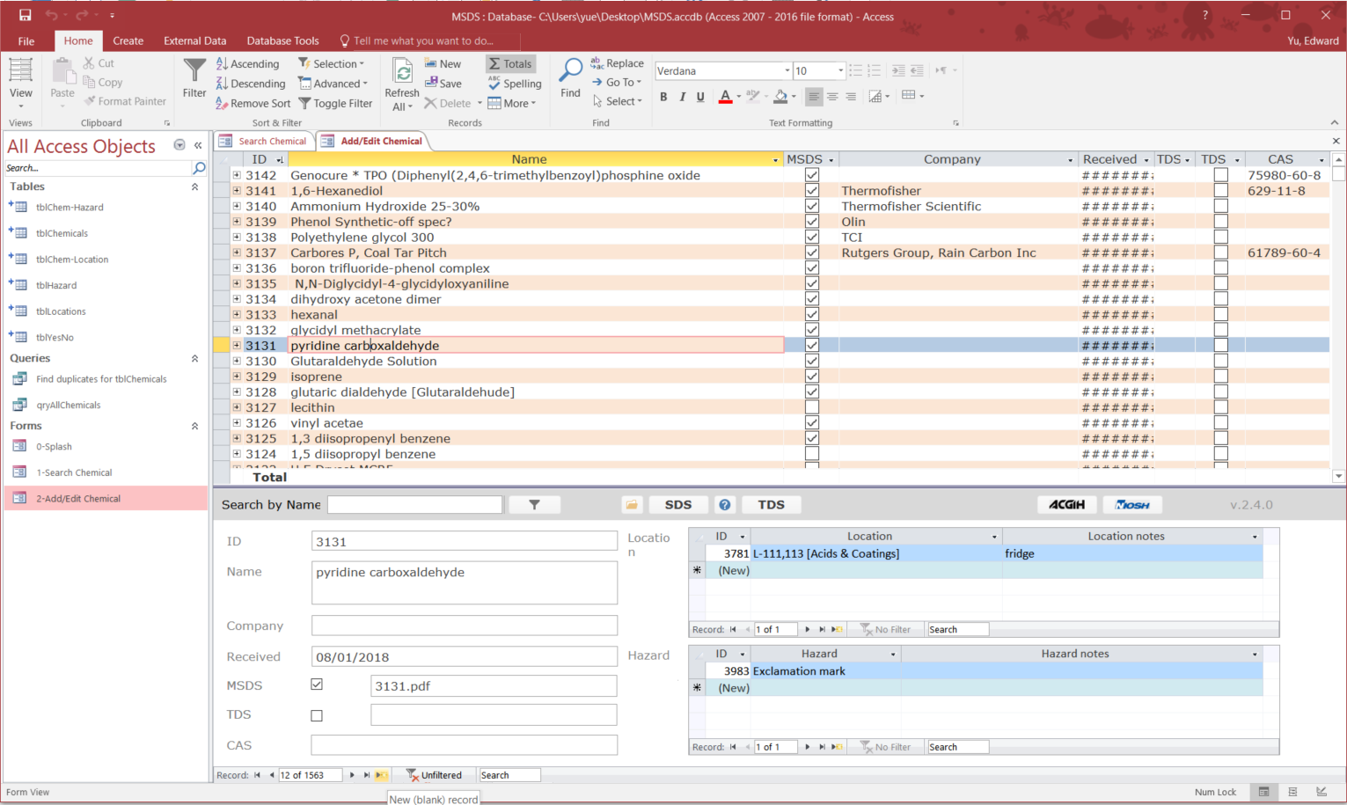
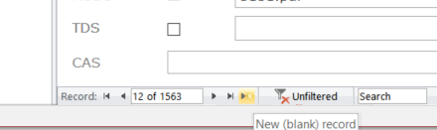
tutorial – add/edit
Notes:
Before adding a new chemical, you’ll of course want to make sure it isn’t in the system already.
After you’ve searched for the chemical in question and ensured it isn’t in the database, click the “New (blank) record” button, circled in red above (right arrow with a yellow asterisk next to it)

Slide 14
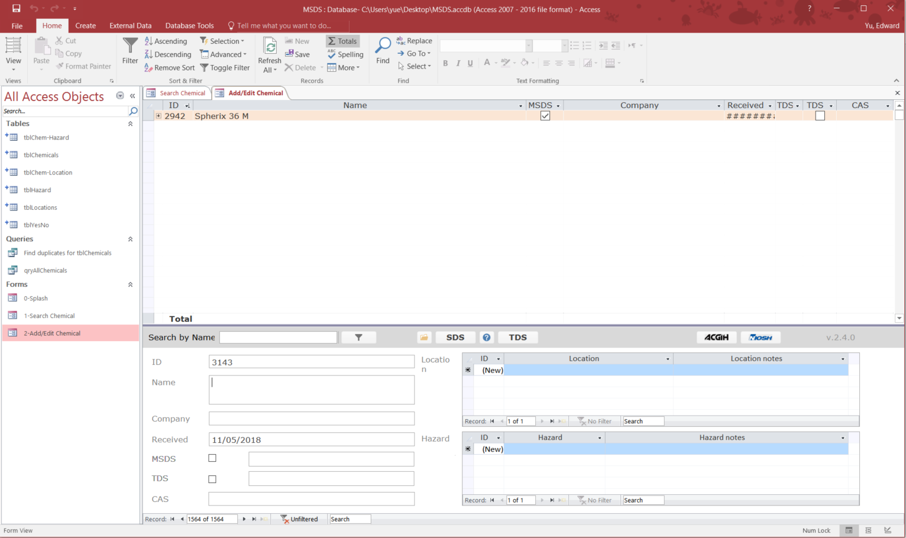
tutorial – add/edit
This creates a new chemical “ID”
With attached information
Notes:
Before adding a new chemical, you’ll of course want to make sure it isn’t in the system already.
After you’ve searched for the chemical in question and ensured it isn’t in the database, click the “New (blank) record” button, circled in red above (right arrow with a yellow asterisk next to it)

Slide 15
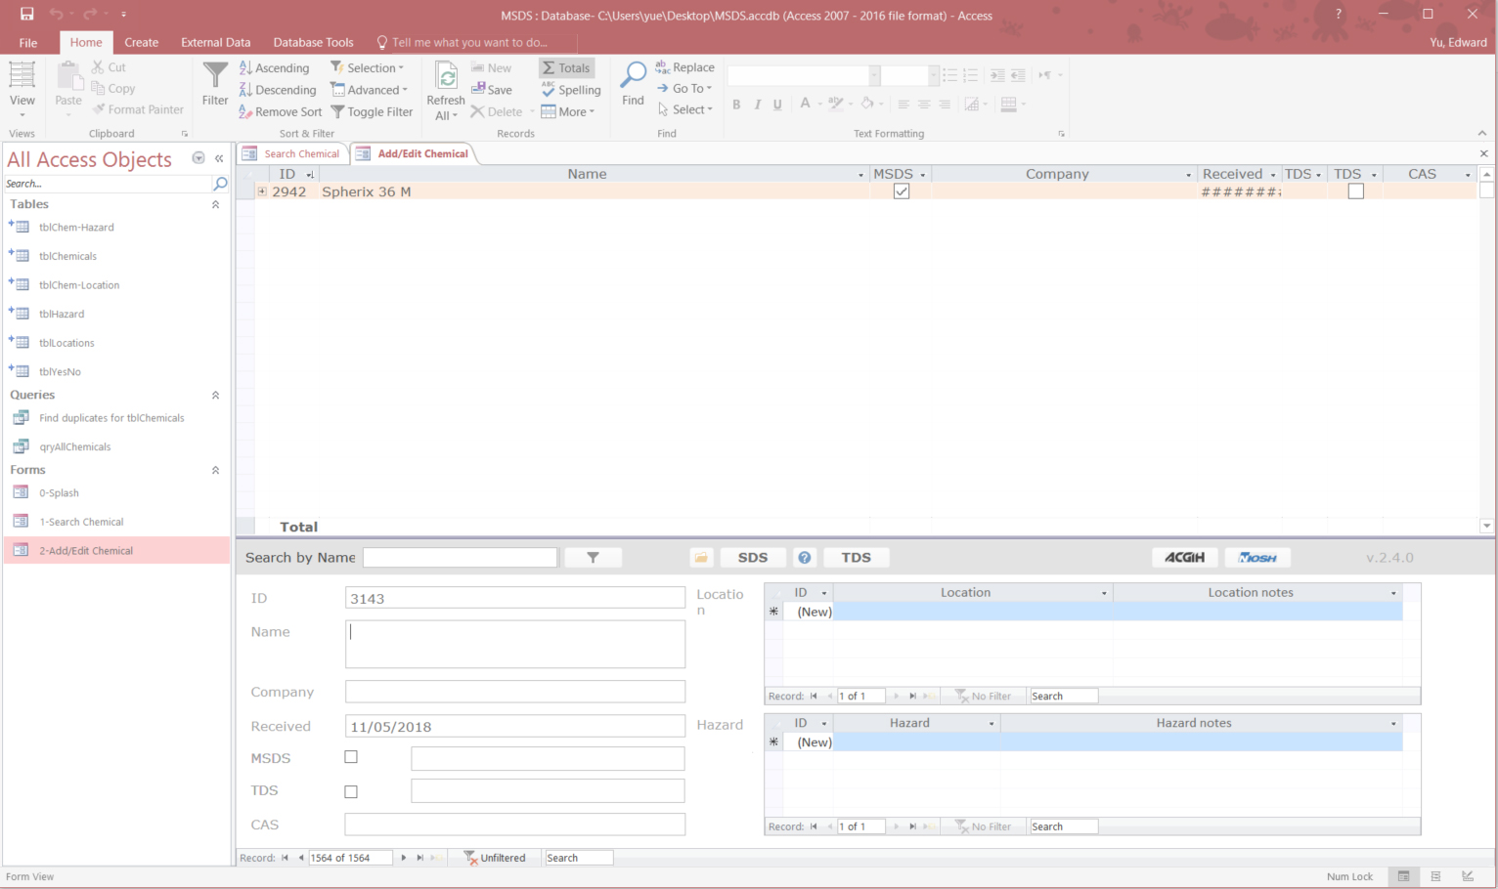
tutorial – add/edit
Fill in appropriate information
ID: automatically generated
Name: chemical name, any synonyms
Company: manufacturer
Received: current date automatically generated, change if needed
CAS: enter CAS number if available
Notes:
Before adding a new chemical, you’ll of course want to make sure it isn’t in the system already.
After you’ve searched for the chemical in question and ensured it isn’t in the database, click the “New (blank) record” button, circled in red above (right arrow with a yellow asterisk next to it)

Slide 16
tutorial – add/edit
“Check” the proper boxes if needed
MSDS: check this box if MSDS will be attached
TDS: check this box if TDS will be attached
Notes:
Before adding a new chemical, you’ll of course want to make sure it isn’t in the system already.
After you’ve searched for the chemical in question and ensured it isn’t in the database, click the “New (blank) record” button, circled in red above (right arrow with a yellow asterisk next to it)

Slide 17
tutorial – add/edit
Select locations and hazards
Location: lab area the chemical is located in, can include multiple areas
Hazard: OSHA hazards (stickers), can include multiple hazards
Notes: add any additional notes here
Notes:
Before adding a new chemical, you’ll of course want to make sure it isn’t in the system already.
After you’ve searched for the chemical in question and ensured it isn’t in the database, click the “New (blank) record” button, circled in red above (right arrow with a yellow asterisk next to it)

Slide 18
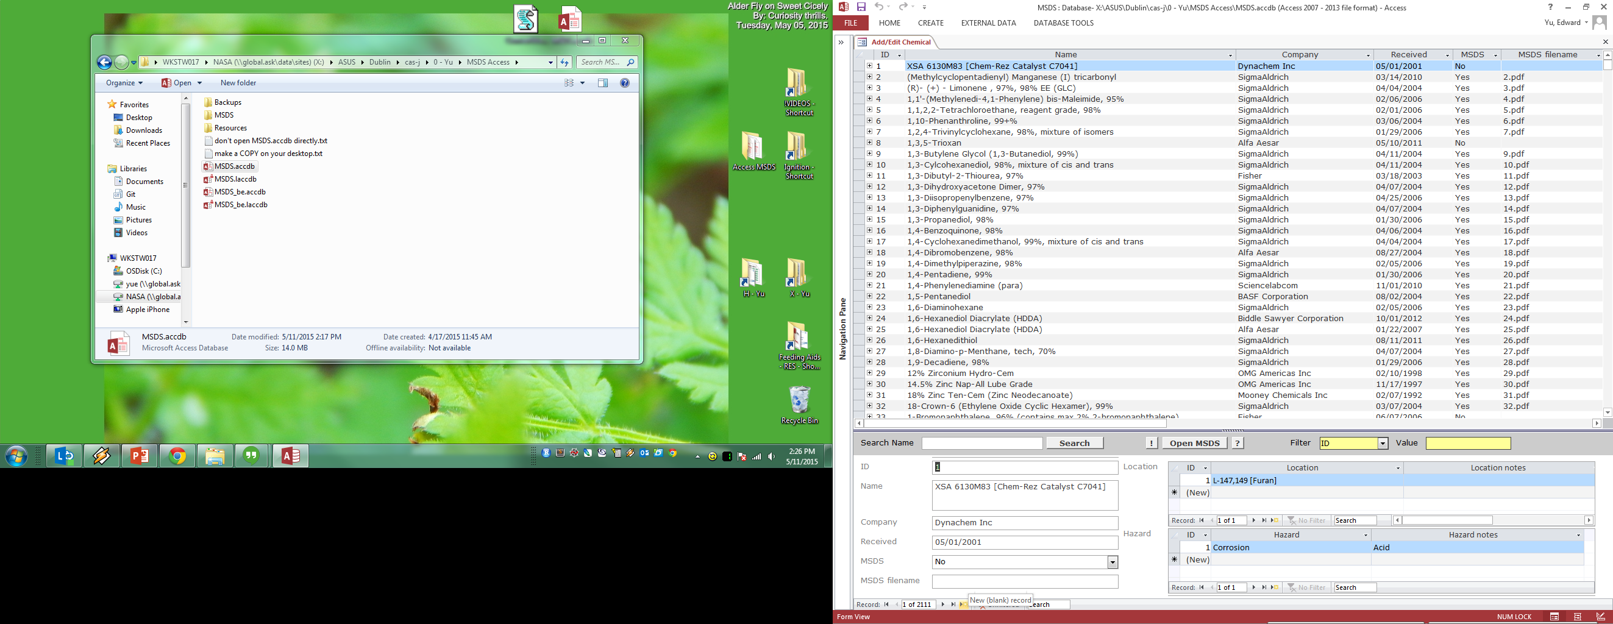
add/edit - example
Click “New (blank) record
Notes:
Before adding a new chemical, you’ll of course want to make sure it isn’t in the system already.
After you’ve searched for the chemical in question and ensured it isn’t in the database, click the “New (blank) record” button, circled in red above (right arrow with a yellow asterisk next to it)

Slide 19
add/edit - example
New ID is autogenerated
Date is autogenerated
Notes:
After clicking the add new record button,
A new entry will be added to the end of the list
In this example, the next ID ends up being 2497, the ID will be different every time

Slide 20
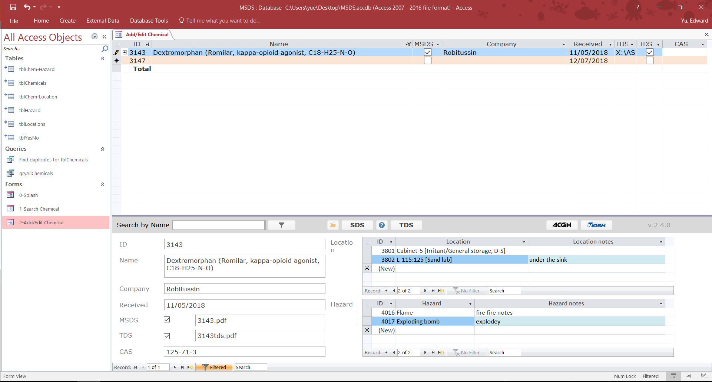
add/edit - example
Fill in names, synonyms
Fill in manufacturer
“Check” box if document available, file extension autogenerated
Fill in CAS #
Select location(s) from dropdown menu
Add notes if appropriate
Select hazard (s) from dropdown menu
Add notes if appropriate
Notes:
After clicking the add new record button,
A new entry will be added to the end of the list
In this example, the next ID ends up being 2497, the ID will be different every time

Slide 21
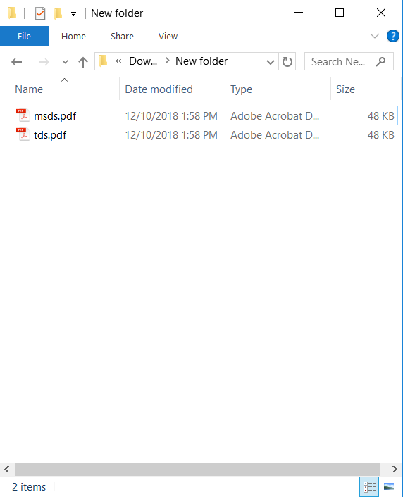
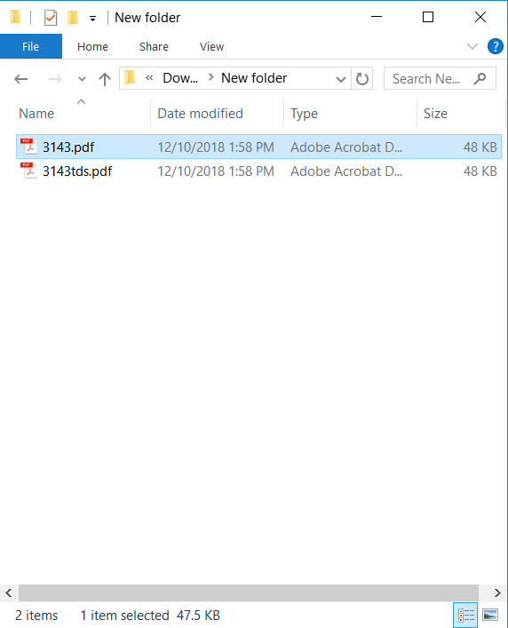
add/edit - example
Assuming you have the SDS and the TDS on your computer, in PDF format…
Rename the files to the autogenerated filenames we saw above
Notes:
Copy the file “MSDS.accdb” to your desktop (or wherever you want it) from the directory: X:\ASUS\Dublin\cas-j\0 - Yu\MSDS Access
This is your own personal copy of the front end.
You’ll be launching this frontend to gain access to the database.
Customize it or ruin it all you want, if you mess it up simply delete it and re-copy the front end from the above location.
Launch the file and to the left you should see some “forms” called:
1-Search Chemical
2-Add/Edit Chemical
Number 1 is basically a “read-only” copy of number 2.
Launch number 1 if you are simply trying to search for an MSDS or find where a chemical is located
Number 2 is used only if you are adding a new chemical or , e.g., need to edit a chemicals location, remove a chemical, etc.

Slide 22
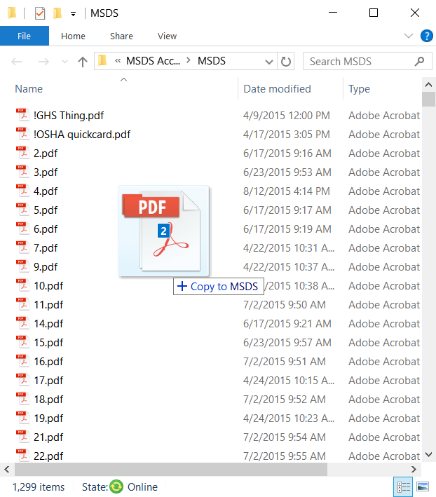
add/edit - example
Open the SDS file location by clicking the “folder” icon
Drag the newly renamed files into this folder
Notes:
Copy the file “MSDS.accdb” to your desktop (or wherever you want it) from the directory: X:\ASUS\Dublin\cas-j\0 - Yu\MSDS Access
This is your own personal copy of the front end.
You’ll be launching this frontend to gain access to the database.
Customize it or ruin it all you want, if you mess it up simply delete it and re-copy the front end from the above location.
Launch the file and to the left you should see some “forms” called:
1-Search Chemical
2-Add/Edit Chemical
Number 1 is basically a “read-only” copy of number 2.
Launch number 1 if you are simply trying to search for an MSDS or find where a chemical is located
Number 2 is used only if you are adding a new chemical or , e.g., need to edit a chemicals location, remove a chemical, etc.

Slide 23
add/edit - example
You should now be able to search for the added chemical as well as open the linked SDS and TDS documents
Notes:
Copy the file “MSDS.accdb” to your desktop (or wherever you want it) from the directory: X:\ASUS\Dublin\cas-j\0 - Yu\MSDS Access
This is your own personal copy of the front end.
You’ll be launching this frontend to gain access to the database.
Customize it or ruin it all you want, if you mess it up simply delete it and re-copy the front end from the above location.
Launch the file and to the left you should see some “forms” called:
1-Search Chemical
2-Add/Edit Chemical
Number 1 is basically a “read-only” copy of number 2.
Launch number 1 if you are simply trying to search for an MSDS or find where a chemical is located
Number 2 is used only if you are adding a new chemical or , e.g., need to edit a chemicals location, remove a chemical, etc.

Slide 24
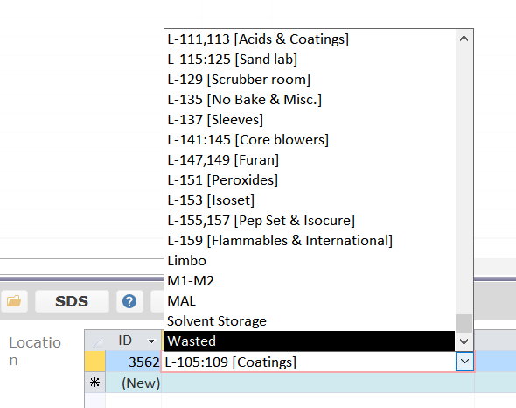
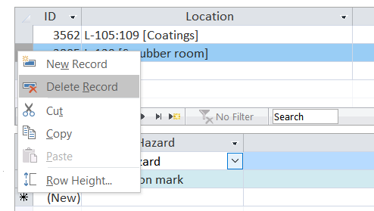
updating location/status
Please keep the locations of chemicals updated!
If you notice a missing chemical, update the location
Right click the far left column and `delete row`, or change the location from the dropdown menu
If you’ve used the last of a chemical, or trashed it
Change the location to `Limbo` or `Wasted`
Notes:
Copy the file “MSDS.accdb” to your desktop (or wherever you want it) from the directory: X:\ASUS\Dublin\cas-j\0 - Yu\MSDS Access
This is your own personal copy of the front end.
You’ll be launching this frontend to gain access to the database.
Customize it or ruin it all you want, if you mess it up simply delete it and re-copy the front end from the above location.
Launch the file and to the left you should see some “forms” called:
1-Search Chemical
2-Add/Edit Chemical
Number 1 is basically a “read-only” copy of number 2.
Launch number 1 if you are simply trying to search for an MSDS or find where a chemical is located
Number 2 is used only if you are adding a new chemical or , e.g., need to edit a chemicals location, remove a chemical, etc.

